Slide 1
Selvakumar13599@gmail.com
DATA @ ANZ

Slide 2
Inference:-
Transaction details of 100 customers over a period of 3 months are given in the dataset.
The number of transactions of the 100 customers are 12043.
The columns present are:-
"status" ,"card_resent_flag" ,"bpay_biller_code" ,"account", "currency“,“long_lat“,"txn_description" "merchant_id“,
"merchant_code“,"first_name","balance“,"date“, "gender“,"age“,"merchant_suburb”,"merchant_state" "extraction“,"amount“,"transaction_id" "country“,"customer_id“,"merchant_long_lat“,"movement"

Slide 3
Inference:-
‘card_present_flag’, ‘bpay_biller_code’, ‘merchant_id’, ‘merchant_code’, ‘merchant_suburb’, ‘merchant_state’, ‘merchant_long_lat’ are columns with missing values.
Average spending of male customers are more than female customers.

Slide 4
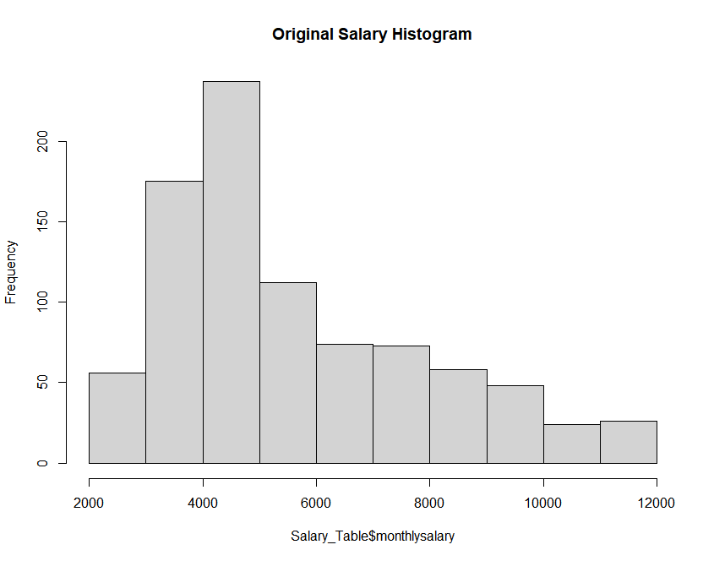
Original Salary Histogram

Slide 5
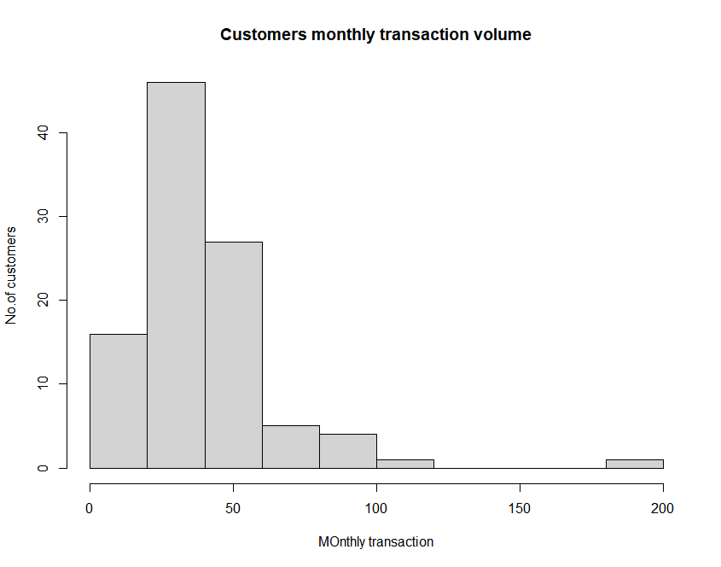
Customer Monthly Transaction

Slide 6
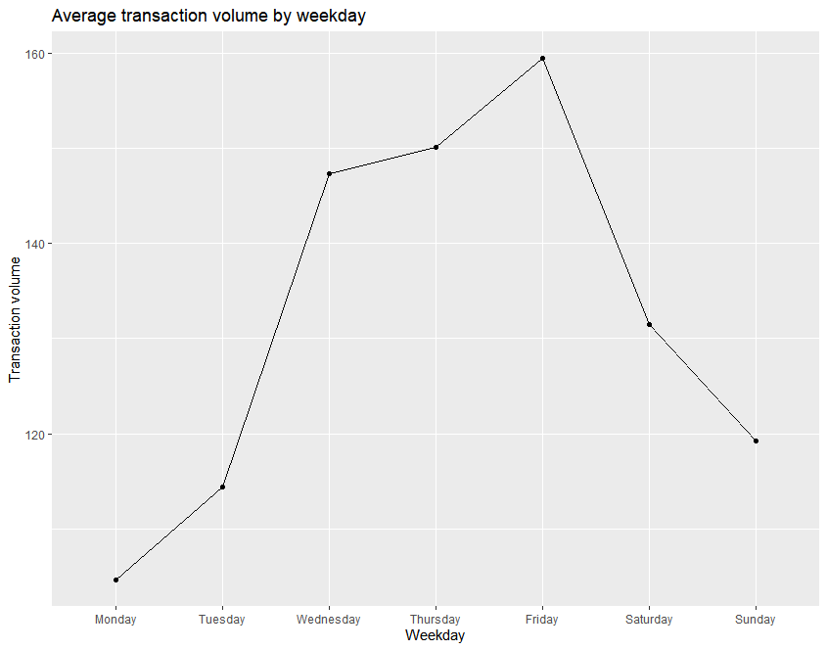
Average Transaction by weekday.

Slide 7
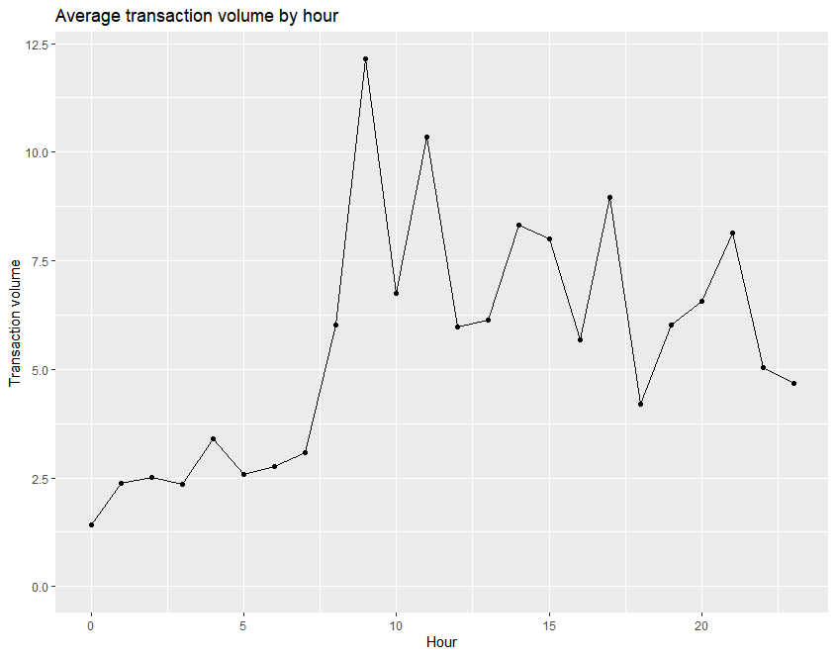
Average Transaction by hour

